Slide 1
TEST 2-STRING COMPARISON EXCERCISE
UI DRAWING FOR THE EXERCISE
NABIL AHAMED S

Slide 2
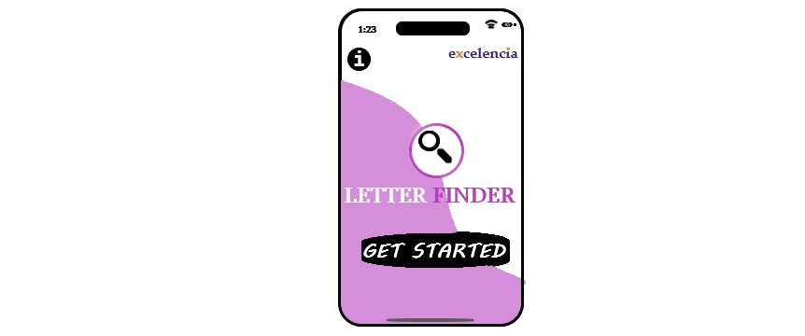
THE FIRST AND FRESH SCREEN OF THE APPLICATION

Slide 3
INFORMATIONS AND HELP
THE COMPANY NAME WHO DEVELOPED THE PRODUCT
-------------
-------------
----------------------
LOGO OF THE PRODUCT
NAME OF THE PRODUCT
----------------
START BUTTON FOR THE APPLICATION TO BEGIN
----------------

Slide 4
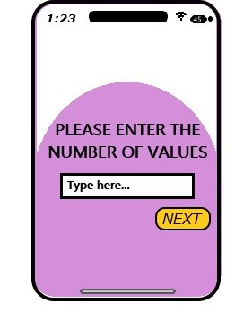
AFTER PRESSING THE GET STARTED
NEW SCREEN OPENED
AND ASKS THE USER THAT THE NUMBER OF VALUES TO COMPARE
HERE WE TYPE THE NUMBER OF VALUES THAT WE WANT TO COMPARE.
AND PRESS
NEXT

Slide 5
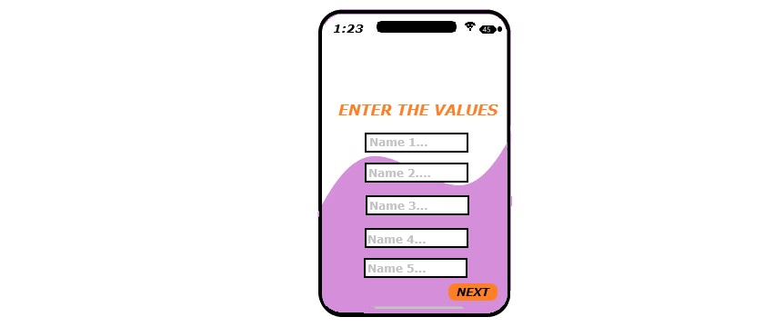
HERE, WE CAN ENTER THE VALUES
HERE WE TYPE THE DIFFERENT VALUES IN EACH BOX
NEXT
AND PRESS

Slide 6
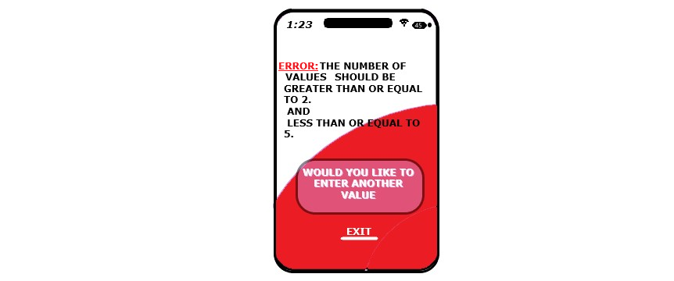
IF WE ENTERED THE VALUE LESS THAN 2 OR GREATER THAN 5 IN THIS SCREEN
THIS SCREEN WILL APPEAR AND ASK THE USER TO ENTER NEW VALUE OR EXIT BY USER WISH.

Slide 7
IF THE USER PRESS "WOULD YOU LIKE TO ENTER NEW VALUE" BUTTON
THIS SCREEN WILL APPEAR AND START FROM BEGINNING

Slide 8
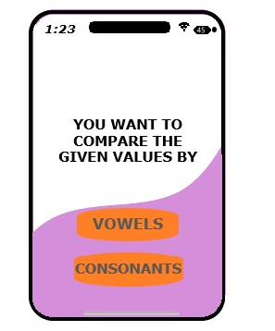
AFTER ENTERED THE VALUES HERE
THE APPEARED SCREEN HERE ASKS THE USER WHETHER YOU COMPARE YOUR VALUES BY "VOWELS" OR "CONSONANTS"

Slide 9
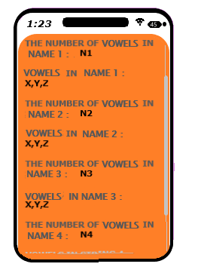
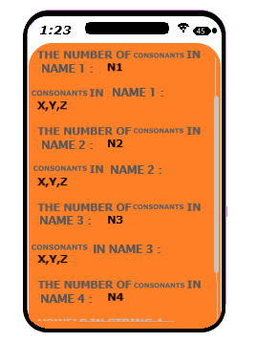
THE RESULT WILL BE APPEARING LIKE
IF VOWELS: IF CONSONANTS:

Slide 10
THANK YOU
NABIL AHAMED S

